Slide 1
SIGNATURE VERIFICATION USING MATLAB
Submitted by:-3108 Shreya Bhattacharjee
3116 Anam Hamdule

Slide 2
Content of project
1.Introduction
2.Purpose of Signature Verification
3. Explanation of our project
4.Output
5.System Description
6. Applications
7. Advantages/Disadvantages
8. References

Slide 3
INTRODUCTION
Signature Verification one of the most widely accepted personal attributes for identity Verification of an person
One of the ways to authorize transactions and authenticate the human identity compared with other electronic identification
Even in todays age signature is the most important and most used form of proof of identity of a person. Signatures are used for all documents in financial services, legal services or on letters, documents, checks, security documents.
Thus to reducing illegal acts like forgery are a great concern in our day and age.
Negligence of signature verification is one of the main cause of fraud in our country.

Slide 4
Purpose of Signature Verification
Everyday Transaction
Individuals less likely to object
Individuals Signature is unique
Less controversial
Two Mode of signature
Offline signature-Deals with shape only
Online signature-Deals with dynamic features like speed, pen, pressure ,direction

Slide 5
Explanation of our project
The GUI of our project consist of several components, including buttons, labels, and axes to display images and results.
The app has the following components: -
UIFigure`: The main figure of the app.
SignatureVerificationPanel`: A panel that contains all the components related to signature verification.
UIAxes: An axes object to display the first signature image. - `UIAxes2`: An axes object to display the second signature image.
UIAxes_2: An axes object to display the grayscale version of the first signature image.
UIAxes_3: An axes object to display the grayscale version of the second signature image.
UIAxes2_2: An axes object to display the matched features between the two signatures.
SelectImageButton: A button to select the first signature image.
SelectImageButton_2`: A button to select the second signature image.
VERIFYButton`: A button to perform the signature verification process.
StatusLabel: A label to display the status of the verification process.
The app also defines three private methods (`verify`, `select`, and `select2`) that handle the button events and perform the necessary operations for signature verification. These methods use global variables `a` and `b` to store the selected signature images.

Slide 6
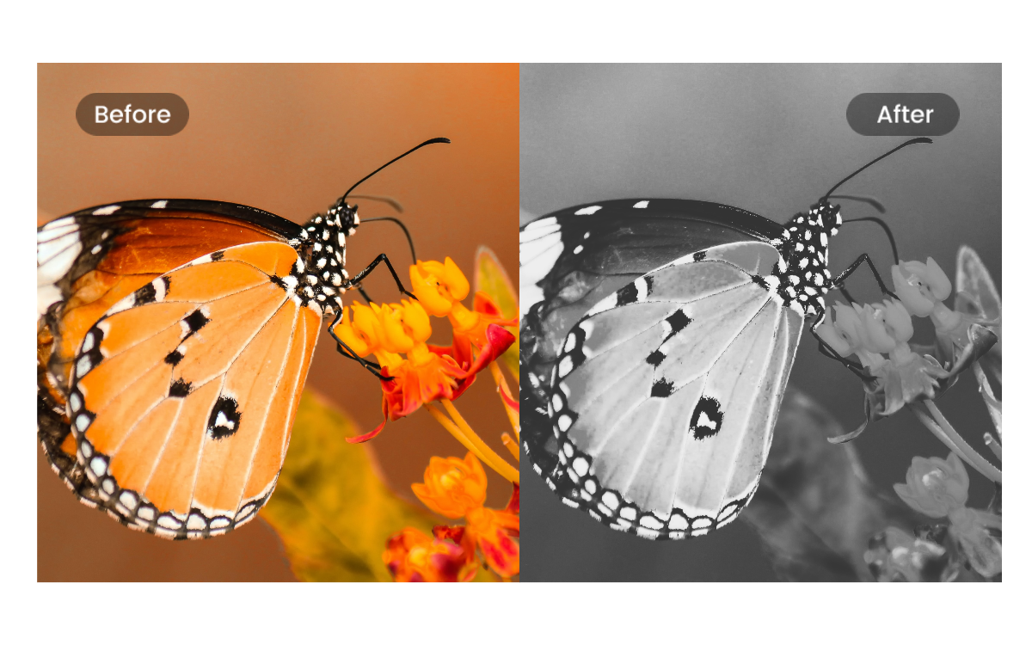
Grey Scale images
Grayscale images are digital images that consist of shades of gray, ranging from black to white, without any color information. Each pixel in a grayscale image is represented by a single intensity value, typically ranging from 0 (black) to 255 (white) in an 8-bit grayscale image.
Grayscale images are commonly used in various image processing and computer vision tasks, as they simplify the image data to focus on the intensity values and remove the complexities of color information. They are often used for tasks such as edge detection, image enhancement, feature extraction, and matching.
When we refer to "2 grayscale images," it means that we have two separate grayscale images, each with its own intensity values. These images can be obtained by converting color images (such as RGB images) to grayscale using techniques like averaging the color channels or using specific conversion formulas.

Slide 7
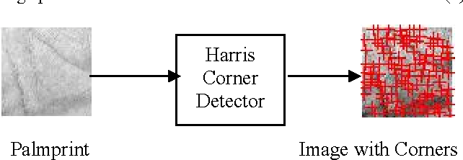
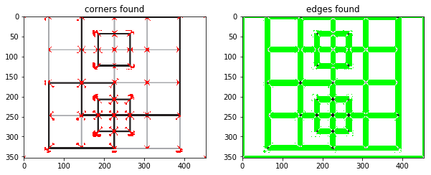
Harris corner detection algorithm
The Harris corner detection algorithm is a popular method for detecting corners in an image. Corners are important features that can be used for matching and registration tasks. The algorithm identifies regions in the image where there are significant changes in intensity in multiple directions, indicating the presence of a corner.
1. Convert the color images to grayscale. Grayscale images simplify the feature detection process by focusing only on the intensity values.
2. Apply the Harris corner detection algorithm to both grayscale images. This algorithm computes a corner response function at each pixel and identifies points with high corner responses as potential corner points.
3. Extract features from the detected corner points. This step involves capturing information around the corner points that can be used for matching. Common techniques include extracting local patches or descriptors around the corners.
4. Match the extracted features between the two images. This is typically done by comparing the descriptors or feature representations from the two images. Various matching algorithms can be used, such as nearest neighbour matching or distance-based matching.
5. Display the results in the specified UIAxes components. The matched features are visualized to provide a visual representation of the matching process. This can help in understanding the quality and accuracy of the matching results.
By performing feature matching using the Harris corner detection algorithm and displaying the results in the specified UIAxes components, the code allows you to visually analyze and compare the matched features between the two grayscale images. This can be useful for various applications, such as object recognition, image registration, or image retrieval.

Slide 8
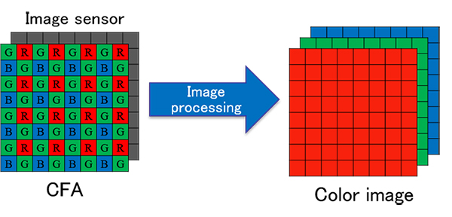
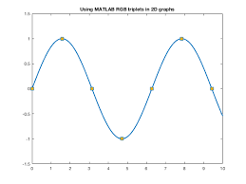
RGB IMAGES
An RGB (Red, Green, Blue) image is a type of digital image that uses three color channels to represent colors. It is the most common color model used in electronic displays, digital cameras, and computer graphics. In an RGB image, each pixel is composed of three color channels: red, green, and blue.
The intensity values of these channels define the color of the pixel. By combining different intensities of red, green, and blue, a wide range of colors can be created. The RGB color model works on the additive color mixing principle. When all three color channels are set to their maximum intensity (usually 255 in an 8-bit representation), the resulting color is white.
When all three color channels are set to their minimum intensity (usually 0), the resulting color is black. By varying the intensity values of the three channels, different colors are formed.

Slide 9
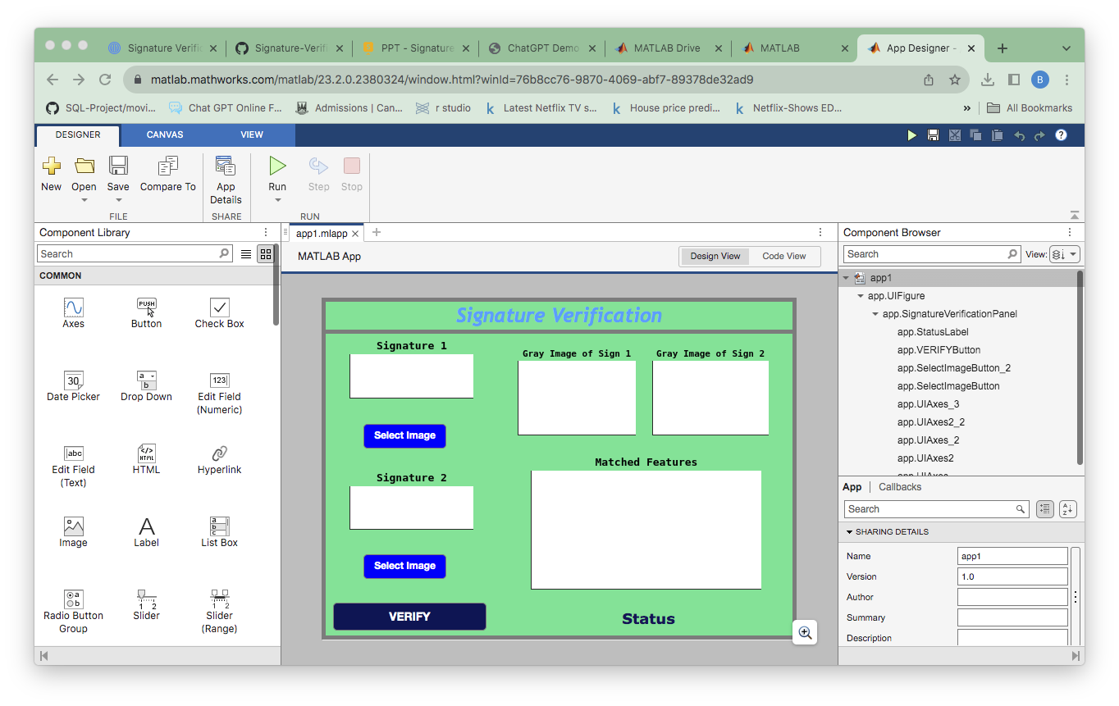
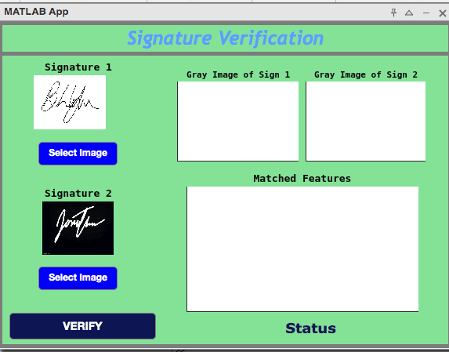
GUI of Signature Verification

Slide 10
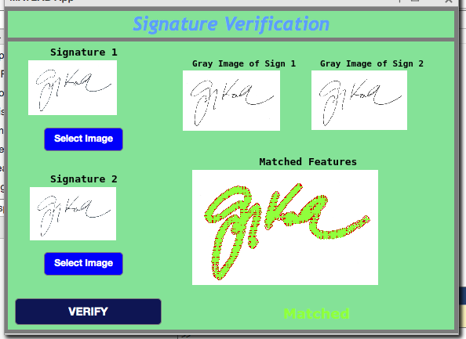
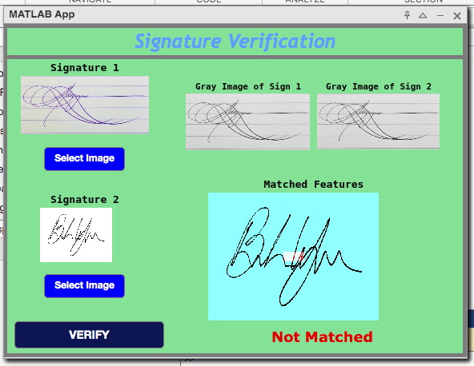
Output

Slide 11
System Description
Data acquisition- The signature is taken from the user where user has to select 2 images.
Two scanned images are taken from user and moving it to processing unit.
Signature pre processing- These pre-processing techniques, the signature data can be enhanced, noise can be reduced, and relevant features can be extracted. This enables more accurate analysis, comparison, and recognition of signatures in various applications such as signature verification, document authentication, or biometric identification.
Feature Extraction- Feature extraction is performed using the Harris corner detection algorithm and matching features between two grayscale images (I1 and I2).
Implementation- Layout of signature verification is formed using GUI ,Algorithm is applied to the button to their respective function.
Signature Verification-Once we have imported both the image it will start verifying both the signature and if both the signature are similar it will show matched else it will show not matched

Slide 12
Applications
Signature verification has various applications across different sectors due to its ability to authenticate the identity of individuals. Some notable sectors where signature verification is commonly used include:
1. Banking and Financial Institutions: Signature verification is widely utilized in banking and financial institutions to verify the authenticity of signatures on checks, loan documents, credit card applications, and other financial transactions. It helps prevent fraud and ensures the integrity of financial transactions.
2. Legal and Contractual Agreements: In the legal sector, signature verification is crucial for verifying signatures on contracts, legal documents, wills, and other important agreements. It ensures that the signatures are genuine and helps maintain the legal validity of the documents.
3. Government and Public Administration: Signature verification is employed in government offices for identity verification, document authentication, and processing various applications such as passports, driver's licenses, voter registration forms, and official permits. It helps ensure the accuracy and legitimacy of government records and processes.
4. Healthcare and Medical Records: Signature verification is used in healthcare settings for verifying signatures on medical consent forms, insurance claims, prescription orders, and other medical documents. It helps protect patient privacy, prevent identity theft, and maintain the integrity of medical records.

Slide 13
ADVANTAGES/DISADVANTAGES
Advantages of Signature Verification:
1. Individuality: Signatures are unique to individuals, making them a potentially reliable biometric identifier for authentication purposes. Each person has a distinct signature style, making it difficult to forge or replicate accurately.
2. Non-intrusive: Signature verification is a non-intrusive biometric authentication method. It doesn't require physical contact or specialized equipment, making it convenient and less invasive for users.
3. Cost-effective: Implementing signature verification systems can be cost-effective compared to other biometric authentication methods. It often requires minimal hardware and can be integrated into existing systems or documents with relative ease.
Disadvantages of Signature Verification:
Variability: Signatures can vary significantly due to factors like mood, fatigue, health, or writing conditions. This variability can lead to inconsistencies in signature appearance, making it challenging to establish a consistent reference for verification.
2. Subjectivity: The interpretation of signature authenticity can be subjective. Different individuals may have varying opinions on whether a signature matches or not, leading to potential errors or disputes in the verification process.
3. Skill and Training: Signature verification requires skilled personnel who are trained in accurately assessing and comparing signatures. It can be challenging to find experts in signature analysis, leading to potential errors or inconsistencies in the verification process.

Slide 14
References
https://in.mathworks.com/matlabcentral/fileexchange/24701-signature-preprocessing-for-signature-verification
https://www.researchgate.net/publication/304625369_Signature_Verification

